Slide 1
From EigenTrust to SHAPE-Trust
Author: Jan Rutterle
Supervisor: doc. Ing. Tomáš Kroupa Ph.D.
1/9

Slide 2
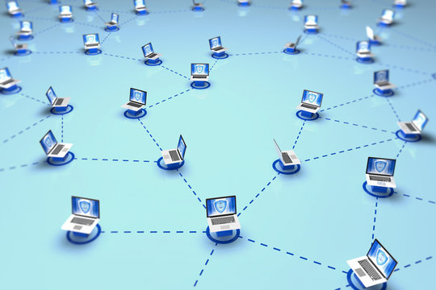
Motivation
Trust in P2P networks
Malicious attacks
2/9

Slide 3
Assignment
Implementation of the algorithms in Julia
Experiments for comparing of the algorithms
SHAPE-Trust characteristics
3/9

Slide 4
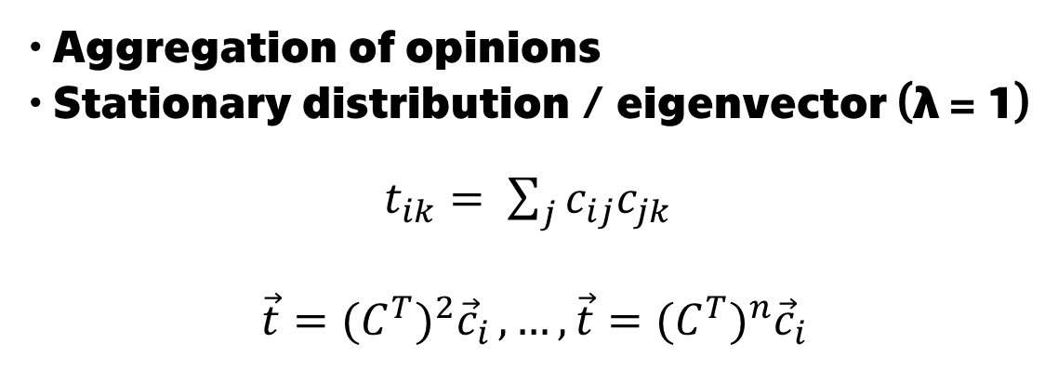
EigenTrust
Aggregation of opinions
Stationary distribution / eigenvector (λ = 1)
$t_{ik}= \sum_{j}{c_{ij}c_{jk}}$
$$\vec{t}={(C^{T})}^{2}{\vec{c}}_{i },…, \vec{t}={(C^{T})}^{n}{\vec{c}}_{i}$$
4/9

Slide 5
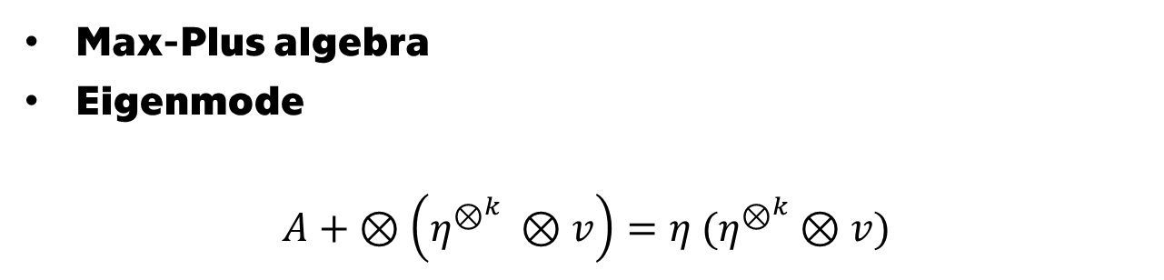
MaxTrust
Max-Plus algebra
Eigenmode
$A+ ⊗\left(η^{⊗^{k}} ⊗v\right)=η$ ${(η}^{⊗^{k}}$ $⊗v)$
5/9

Slide 6
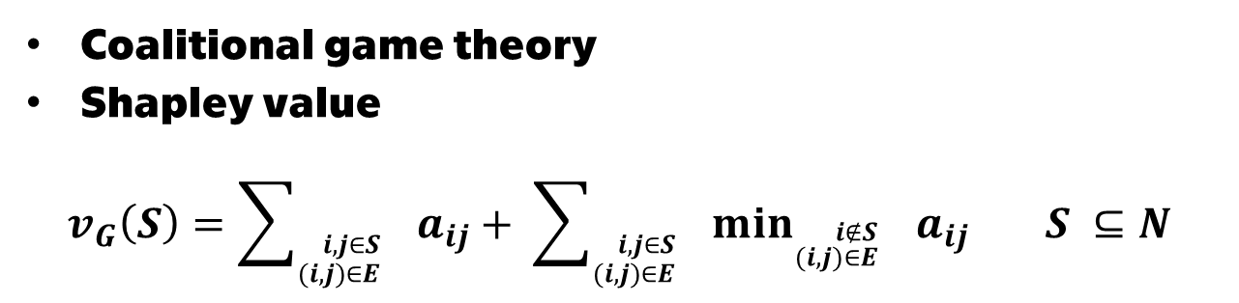
SHAPE-Trust
Coalitional game theory
Shapley value
$v_{G}\left(S\right)=\sum_{{}_{(i,j)∈E}^{i,j∈S}{}}{a_{ij}+ }$ $\sum_{{}_{(i,j)∈E}^{i,j∈S}{}}{{\min_{{}_{(i,j)∈E}^{i∉S}{}}{a}}_{ij} S ⊆N }$
6/9

Slide 7
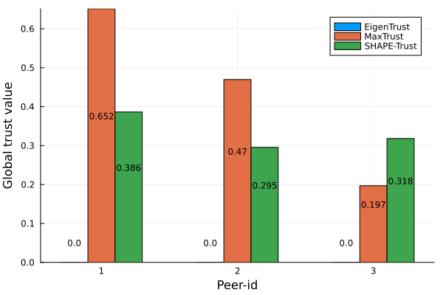
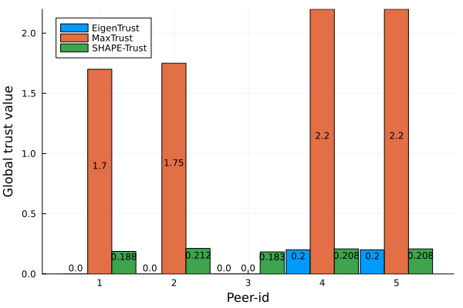
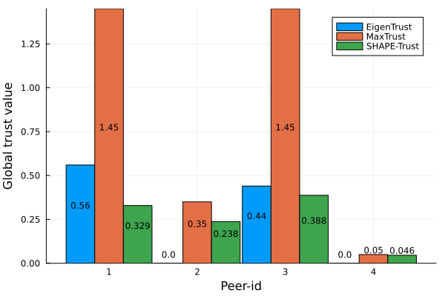
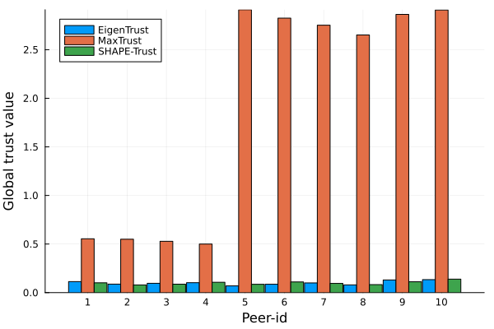
Experiments
7/9

Slide 8
Conclusion
This thesis:
Implemented all algorithms in Julia
Compared all algorithms on specific instances
Future research:
Experiments with real data
8/9

Slide 9
Thank You For Your Attention
9/9

Slide 10
Reviewer’s Question 1
Figure 1.5: Algorithm 2: There is a parameter “a” in the algorithm, which represents the convex combination of two vectors. What value is chosen for “a” in the thesis?

Slide 11
Reviewer’s Question 2
Do you have any idea about the difference between time complexity of both methods?

Slide 12
Reviewer’s Question 3
Table 4.2: According to the graph in Figure 4.5, peer-2 and peer-4 are assigned the same value 0.0, although the author presents the ordering as 3. And 4., respectively. Such an ordering supports the claim that “all algorithms rated the peers appropriately”. My question is why did the author choose this ordering, despite the values being the same?

